Slide 1
EXCEPTION

Slide 2
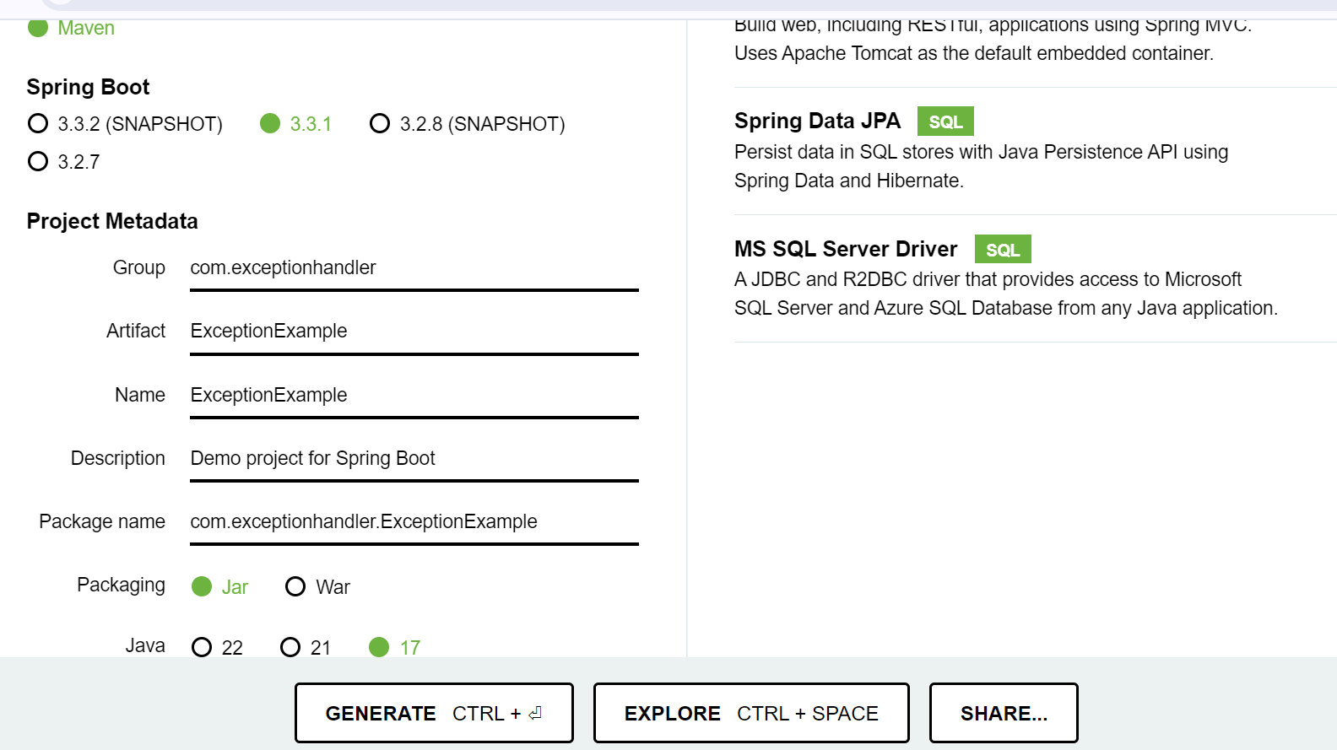
Spring Boot Exception Example:
Open Spring Initializr http://start.spring.io.
Add denpendencies:
  spring web
  mysql driver
  springboot data JPA
Click GENERATE CTRL+

Slide 3
One zip file will generate & download →Extract it → open it in Intellij → Open pom.xml file
Make chages Like ,
  version : 2.7.14, java version : 8
Every changes give save all → clean → install
Delete 'Test' folder and restart ( file → invalid caches → restart )
Create package (name - model) → create class (name - User)
Declare ‘@Entity’ in model class → declare variables → provide default constructor, getter and setter, parameterized constructor
give @Table(name = "user")
in above id
@Id
@GeneratedValue(strategy = GenerationType.AUTO)
in above firstname
@Column(name = "first_name")
in above lastname
@Column(name = "last_name")
in above email
@Column(name = "email")

Slide 4
Program: (class - User)
package com.exceptionhandler.ExceptionExample.model;
import javax.persistence.*;
@Entity
@Table(name = "user")
public class User {
@Id
@GeneratedValue(strategy = GenerationType.AUTO)
private long id;
@Column(name = "first_name")
private String firstName;
@Column(name = "last_name")
private String lastName;
@Column(name = "email")
private String email;

Slide 5
public User(){
}
public long getId() {
return id;
}
public void setId(long id) {
this.id = id;
}
public String getFirstName() {
return firstName;
}
public void setFirstName(String firstName) {
this.firstName = firstName;
}
public String getLastName() {
return lastName;
}
public void setLastName(String lastName) {
this.lastName = lastName;
}
public String getEmail() {
return email;
}
public void setEmail(String email) {
this.email = email;
}
public User(long id, String firstName, String lastName, String email) {
this.id = id;
this.firstName = firstName;
this.lastName = lastName;
this.email = email;
}
}

Slide 6
Create package (name - repository) → create interface (UserRepository)
Program: (interface)
package com.exceptionhandler.ExceptionExample.repository;
import com.exceptionhandler.ExceptionExample.model.User;
import org.springframework.data.jpa.repository.JpaRepository;
import org.springframework.stereotype.Repository;
@Repository
public interface UserRepository extends JpaRepository<User,Long> {
}
Create package (name - exception) → create class (name - ErrorDetails) → declare private variables (timestamp, message, details) → provide constructor, getter and setter methods → create class (name - ResourceNotFoundException) → create class (name - GlobalExceptionHandler)

Slide 7
Program: (class - ErrorDetails)
package com.exceptionhandler.ExceptionExample.exception;
import java.util.Date;
public class ErrorDetails {
private Date timestamp;
private String message;
private String details;
public ErrorDetails(Date timestamp, String message, String details) {
super();
this.timestamp = timestamp;
this.message = message;
this.details = details;
}
public Date getTimestamp() {
return timestamp;
}
public void setTimestamp(Date timestamp) {
this.timestamp = timestamp;
}
public String getMessage() {
return message;
}
public void setMessage(String message) {
this.message = message;
}
public String getDetails() {
return details;
}
public void setDetails(String details) {
this.details = details;
}
}

Slide 8
Program: (class - ResourceNotFoundException)
package com.exceptionhandler.ExceptionExample.exception;
import org.springframework.http.HttpStatus;
import org.springframework.web.bind.annotation.ResponseStatus;
@ResponseStatus(value = HttpStatus.NOT_FOUND)
public class ResourceNotFoundException extends RuntimeException{
private static final long serialVersionUID=1l;
public ResourceNotFoundException(String message){
super(message);
}
}
Program: (class - GlobalExceptionHandler)
package com.exceptionhandler.ExceptionExample.exception;
import org.springframework.http.HttpStatus;
import org.springframework.http.ResponseEntity;
import org.springframework.web.bind.annotation.ControllerAdvice;
import org.springframework.web.bind.annotation.ExceptionHandler;
import org.springframework.web.context.request.WebRequest;
import java.util.Date;

Slide 9
@ControllerAdvice
public class GlobalExceptionHandler {
@ExceptionHandler(ResourceNotFoundException.class)
public ResponseEntity<?> resourceNotFoundHandling(ResourceNotFoundException resourceNotFoundException, WebRequest request){
ErrorDetails errorDetails=new ErrorDetails(new Date(),resourceNotFoundException.getMessage(),request.getDescription(false));
return new ResponseEntity(errorDetails, HttpStatus.NOT_FOUND);
}
@ExceptionHandler(Exception.class)
public ResponseEntity<?> globalExceptionHandling(Exception exception, WebRequest request){
ErrorDetails errorDetails=new ErrorDetails(new Date(),exception.getMessage(),request.getDescription(false));
return new ResponseEntity<>(errorDetails, HttpStatus.INTERNAL_SERVER_ERROR);
}
}
Create package (name - controller) → create class (name - UserController)

Slide 10
Program: (UserController)
package com.exceptionhandler.ExceptionExample.controller;
import com.exceptionhandler.ExceptionExample.exception.ResourceNotFoundException;
import com.exceptionhandler.ExceptionExample.model.User;
import com.exceptionhandler.ExceptionExample.repository.UserRepository;
import org.springframework.beans.factory.annotation.Autowired;
import org.springframework.http.ResponseEntity;
import org.springframework.web.bind.annotation.*;
import java.util.List;
@RestController
@RequestMapping(value = "/api")
public class UserController {
@Autowired
UserRepository userRepository;
// get all user
@DeleteMapping("/{id}")
public ResponseEntity<User> deleteUser(@PathVariable("id") long id){
User existingUser=this.userRepository.findById(id).orElseThrow(()->new ResourceNotFoundException("User not found with id :"+id));
this.userRepository.delete(existingUser);
return ResponseEntity.ok().build();
}
}

Slide 11
Save all → clean → install
run → Final o/p show below
  Tomcat started ………………..
  Started ExceptionExample …………………..
open xamp server → open created database → open postman → select delete → give url path (http://localhost:9901/api/2) → click body, raw, JSON → click send → o/p will show below like
    ({
    "timestamp": "2024-07-05T09:16:44.706+00:00",
    "message": "User not found with id :2",
    "details": "uri=/api/2"
    } )

